Slide 1
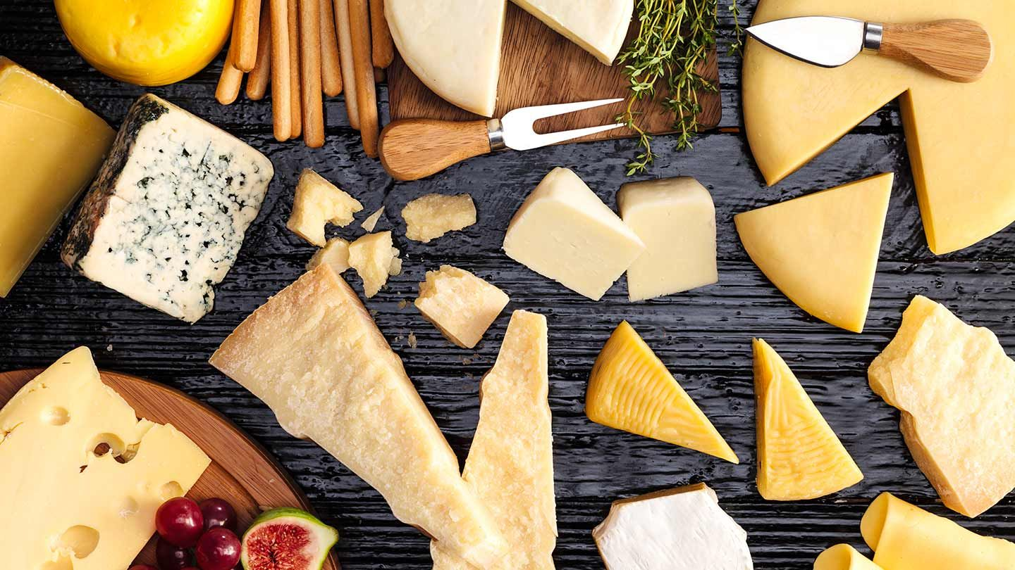
PROJECT ON ENTREPRENEURSHIP
Development of cheese Manufacturing Industry
Guided By –
Dr . Apurba Giri
( Assistant Professor and Head)
Ayan Mandal
( Assestent Professor)
Department of Nutrition
Mugberia Gangabhar Mahavidyalay
Projected By
Supratim Parua
( B.Voc Food Processing 6th Sem
Departmient of Nutrition
Mugberia Gangabhar Mahavidyalay

Slide 3
CONTENTS
Introduction
Location
Licenses
Raw material
Investment
Man power
Flow Diagram
Production
Loan
Target Coustomers
Marketing strategies
Profits
Laboratory testing
Plants layout

Slide 4
Introduction
Cheese making is a process of controlled removal of moisture from milk by acid and temperature manipulation. Ultimately , most of the casein,fat and insoluble.

Slide 5
Location
For the cheese manufacturing business,I select the location nearest of Haria , Purba Medinipur, West Bengal Due to the good source of Raw material like milk, low cost of man power, Good Coustomers demand and good travelling scope.

Slide 6
Licenses
Pollution certificate
Gst certificate
Trade license
FASSI Registration

Slide 7
Raw material
Milk
Culture:- Cheese Stater culture are Predominantly Composed of lactic acid bacteria . Although other bacteria and yeasts may also be involved in cheese manufacturing , the primary role of stater culture is the production of lactic acid from loctose at a predictable and controlled rate.
Vegetable Rennet:- vegetable Rennet is made from plant enzymes that have coagulating properties. Vegetable Rennet may be prepared with plant such as tristle, artichokes and nettles. But Other plants like ground ivy , dried caper lives also been known to serve as coagulant.

Slide 8
Investment
Machinery
Pasteurizer-1Lakes
Cheese coagulation tranj:- 1.5 Lakes
Curd making machine – 85000
Packaging machinery- 1 Lakes
Building - 30000

Slide 9
Man power
Area | Worker | Salary/Month
Security Guard | 1 | 9000
Receiving | 1 | 7000
Production | 4 | 10000
Packaging | 2 | 7000
Laboratory | Lab – Incharge-1 | 20000

Slide 10
Flow diagram
Pre heating and Standardization
Pasteurization
( 62°C At 30 minutes)
Receiving milk
Cutting and Cooling of curd
Adding of state culture
Coagulation
Packaging
Salting
Ripening
Drain the whey

Slide 11
Production
Product | Quentity | Rate
Milk | 1000liters | 40000
Cheese | 100Kg | 80000

Slide 12
Loan
National Bank for Agriculture and Rural Development ( NABARD)
Cridet guarantee scheme (GCS).
Pradhan Mantri Mudra Yojana.
Stand up India Scheme.
Cori Udyani Yojana.
Bank credit Facilitation.
Market development Assestent.

Slide 13
Target Coustomers
Wholesale
Distributor
Retailers
Stores
Grocery shopes
Hotels
Restaurants

Slide 14
Marketing strategies
Personal selling
Advertising
Sales promotion
Direct Marketing
publicity

Slide 15
Profits
Per day investment
Milk- 1000*40=40000
Rennet 0.08*1000=80ml
1ml rennet=30
80 ml Rennet 80*30=2400
Stater culture:- 10*750=7500
Man power/day:-90000/30=3000
Total:- 53900
Per day production
100kg cheese:- 100*800=80000
Profits
80000-53900=26100

Slide 16
Laboratory testing
Test of raw milk
Fat
SNF
Casin
Clot on Boiling
Alcohol test
Acidity
PH
Test of Cheese
Microbiology Analysis
Chemistry Analysis
Allergen Analysis
Potable water Analysis

Slide 17
Plant layout

